Slide 1

BLOCKCHAIN
Prof. Sunitha R
Department of Computer Science Engineering

Slide 2

BLOCKCHAIN
Permission-less Blockchain
Prof. Sunitha R
Department of Computer Science Engineering

Slide 3
BLOCKCHAIN
Learning Content
Learn about the permission-less blockchain structure, Working Procedure and construction.

Slide 4
BLOCKCHAIN
Permission-less Blockchain
Works in an open environment and over a large network of participants
The users do not need to know the identity of the peers, and hence the users do not need to reveal their identity to others
Good for financial applications like banking using cryptocurrency

Slide 5
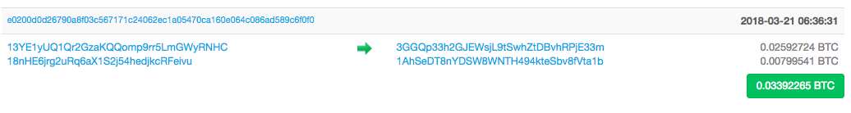
BLOCKCHAIN
Privacy and Security
The system is tamper proof – it is “extremely hard” to make a change in the blockchain
Tampering the system becomes harder as the chain grows
For Bitcoin, the transactions are pseudo-anonymous
Transactions are sent to public key addresses,- cryptographically generated addresses, computed by the wallet applications

Slide 6
BLOCKCHAIN
Peer Addresses (Reference: Bitcoin)
“Address” in bitcoin is synonymous to an “Account” in a bank.
The wallet listens for transactions addressed to an account,
Encrypts the transactions by the public key of the target address
Only the target node can decrypt the transaction and accept it
However, the actual transaction amount is open to all for validation

Slide 7
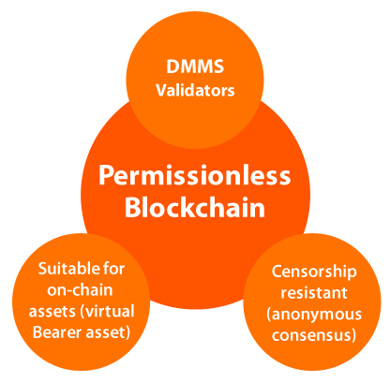
BLOCKCHAIN
Features

Slide 8
BLOCKCHAIN
Blockchain (at Permission-less Model) as a Tree
Block 3
Block 6
Block 1
Block 2
Block 5
Block 7
Block 8
Block 12
Block 4
Block 9
Block 11
Block 10
The longest chain is the accepted chain

Slide 9
BLOCKCHAIN
Accepting the Longest Chain

Slide 10
BLOCKCHAIN
Accepting the Longest Chain

Slide 11
BLOCKCHAIN
Accepting the Longest Chain
A new block is mined

Slide 12
BLOCKCHAIN
Accepting the Longest Chain
Always include it in the longest chain

Slide 13
BLOCKCHAIN
Orphaned Blocks
Block 3
Block 6
Block 1
Block 2
Block 5
Block 7
Block 8
Block 12
Block 4
Block 9
Block 11
Block 10
The blocks which are not part of the longest chain

Slide 14
BLOCKCHAIN
Architecture

Slide 15
BLOCKCHAIN
Advantages
Supports a high number of readers and writers
High public verifiability
High security and immutability
Consistent state of blockchain across all users.

Slide 16
BLOCKCHAIN
Disadvantages
Time consuming
Low latency and low throughput.
Large amount of transactional fee compared to private blockchain.
Scalability and Data Privacy is a concern.

Slide 17
BLOCKCHAIN
Supplementary readings
Notes:
Public Blockchain Ledger
This blockchain is totally open to all and anybody can join the system. Each member on the chain has full power to access, read and write transactions. Since it is decentralized and wholly distributed, every node gives verification to approve any transaction. Data can’t be altered or manipulated once it is placed on the block. Public blockchains are also called permissionless blockchains.
Being totally open to everyone is the biggest drawback of this type of ledger, since it offers complete transparency with little privacy. Time taken to reach consensus by the network is high because of the numerous nodes present, therefore resulting in high computational power. Bitcoin, Ethereum, etc are popular examples.
Private blockchain Ledger
Also called permissioned blockchains, they have limitations on who is participating in the network. A user is granted access only by the network initiator or by a predefined set of rules. Once a user is given entrance to the network, it can perform the same duties as that of other users. Again, the degree of permissions is decided by the one who initiated the network.

Slide 18
BLOCKCHAIN
Supplementary readings
https://ieeexplore.ieee.org/document/8751306
https://ieeexplore.ieee.org/document/8672629
https://ieeexplore.ieee.org/document/8513729
Notes:
Public Blockchain Ledger
This blockchain is totally open to all and anybody can join the system. Each member on the chain has full power to access, read and write transactions. Since it is decentralized and wholly distributed, every node gives verification to approve any transaction. Data can’t be altered or manipulated once it is placed on the block. Public blockchains are also called permissionless blockchains.
Being totally open to everyone is the biggest drawback of this type of ledger, since it offers complete transparency with little privacy. Time taken to reach consensus by the network is high because of the numerous nodes present, therefore resulting in high computational power. Bitcoin, Ethereum, etc are popular examples.
Private blockchain Ledger
Also called permissioned blockchains, they have limitations on who is participating in the network. A user is granted access only by the network initiator or by a predefined set of rules. Once a user is given entrance to the network, it can perform the same duties as that of other users. Again, the degree of permissions is decided by the one who initiated the network.

Slide 19
THANK YOU
Sunitha R
Department of Computer Science Engineering
sunithar@pes.edu
+91 80 6666 3333 Extn 721

